Slide 1

The Battel of Neighborhoods
-- City of Toronto
2020. August. 25th

Slide 2

Problem
Population of City of Toronto is rising every year, which brings more requirements on the city services, as well as the medical services. However, within Toronto, the medical service sites are not located evenly based on the population, some boroughs have more sites than the others.

Slide 3
Target Audience
This report target audience are City of Toronto, and the medical service provides, who want to open a new medical service site in Toronto.
With this report, they will have a clear view to help them to decide the new medical service site location.

Slide 4
Data Set
First, get Toronto neighbourhoods Postal Codes from Wikipedia , and get the neighbourhood longitude & latitude data from geocoder. Combine these two dataframe to get the neighbourhood location dataframe.
Second, get Toronto neighbourhoods population (2011 census) from City of Toronto
At last, get venue info from Foursquare for the neighborhoods North York and Downtown Toronto

Slide 5
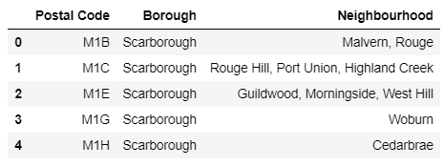
Toronto Neighborhoods Postal Code (sample)

Slide 6
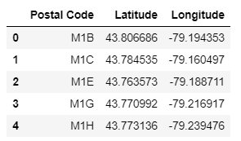
Toronto GPS (sample)

Slide 7
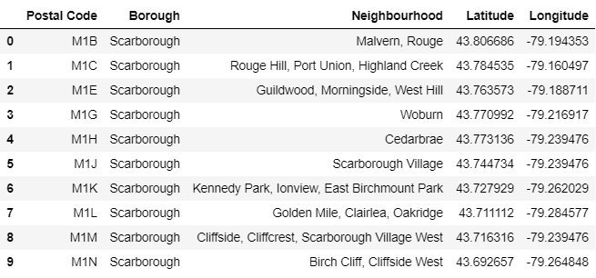
Toronto Neighborhoods GPS (sample)

Slide 8
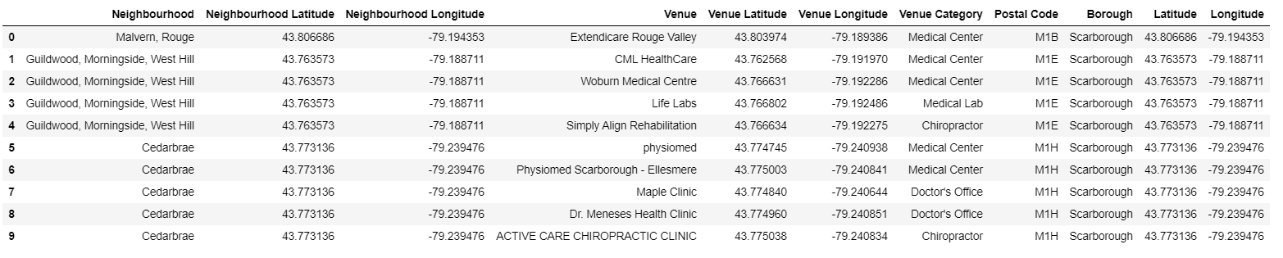
Toronto Neighborhoods Medical Service Centers (sample)

Slide 9
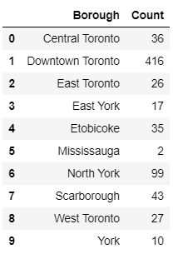
Toronto Medical Service Centers Count by Neighborhoods

Slide 10
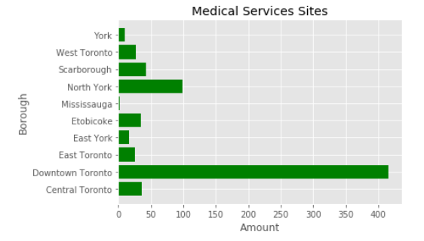
Toronto Medical Service Centers Count by Neighborhoods

Slide 11
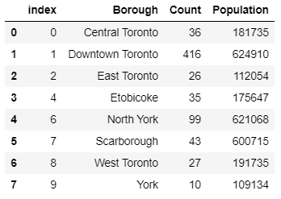
Toronto Medical Service Centers & Population

Slide 12
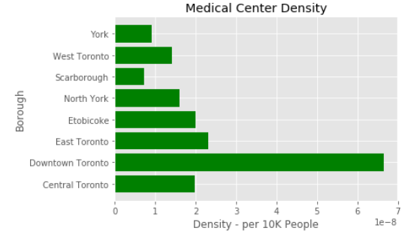
Toronto Medical Service Centers Density

Slide 13

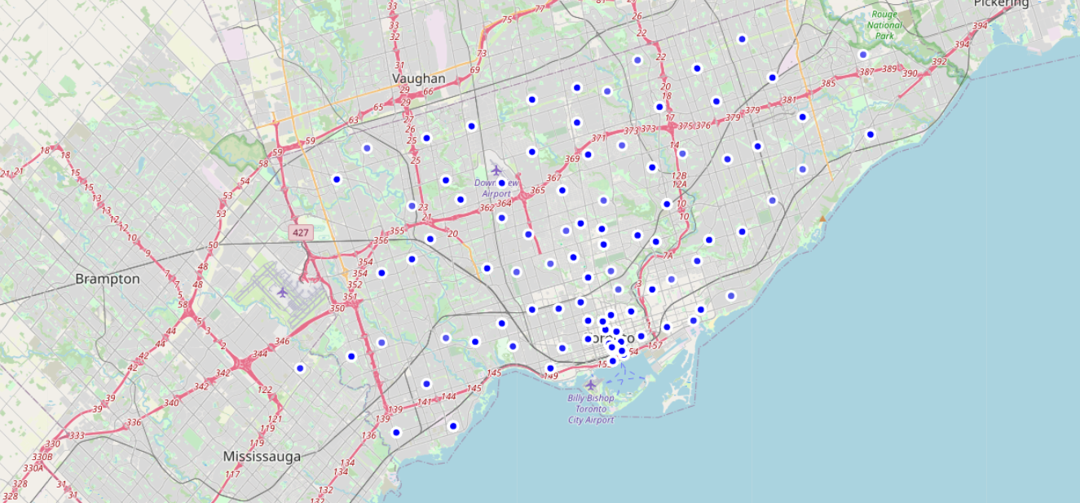
Toronto Medical Service Sites Location

Slide 14
Results
The Chart and the map indicate Downtown Toronto has the most medical service sites, North York has the 2nd most sites. As well, based on the density chart, Downtown Toronto per 10K people have 6.6 medical service sites. While Scarborough only have 0.7 site per 10K people.

Slide 15
Conclusion
Based on the above results, when having the capability to run a medical service site, Scarborough is the Borough where can be considered as a location.

